Slide 1
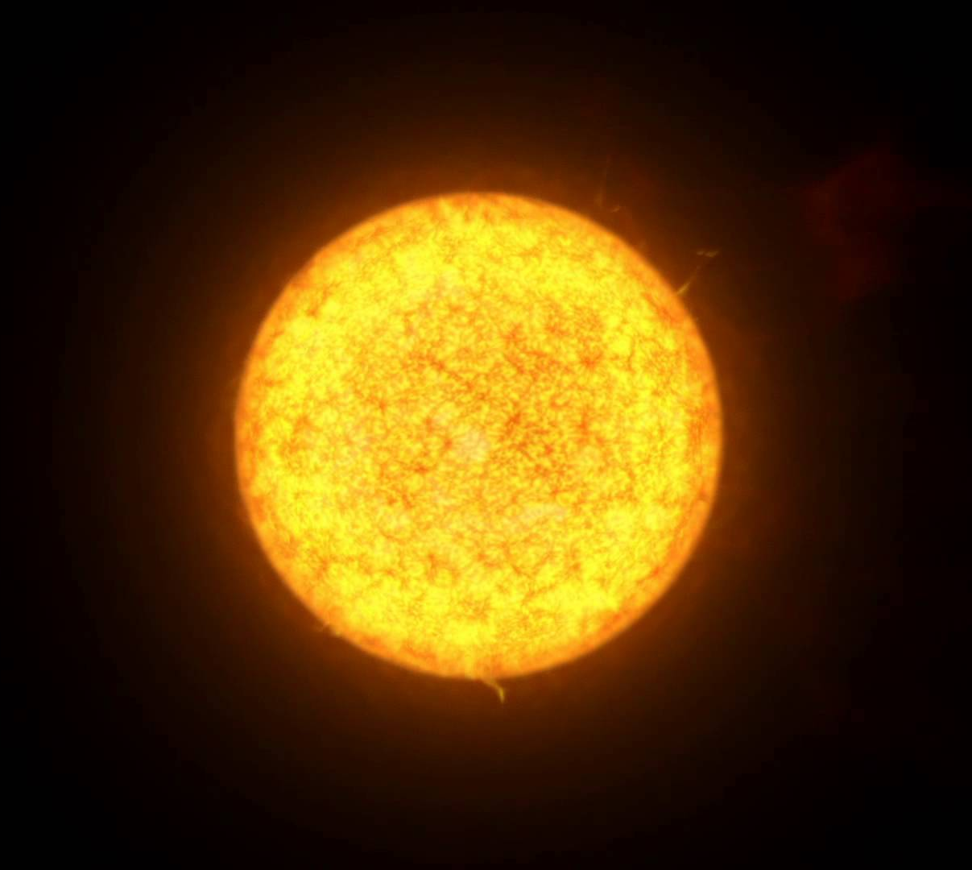
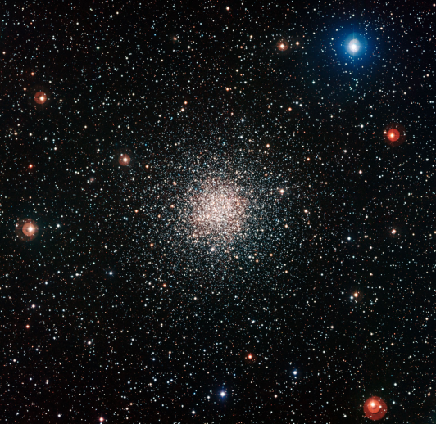
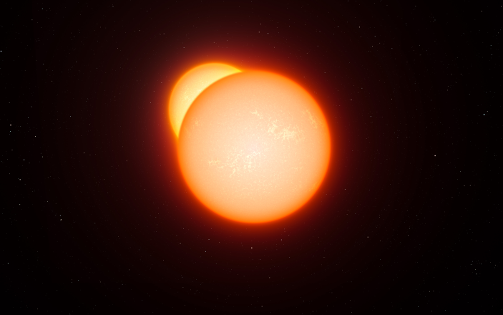
Variable Stars
By: Callum Brennan-Rich, Joshua Eeles and Megan Kirkman

Slide 2
Variable Stars Are:
Stars that fluctuate in magnitude periodically
Generally very bright
Often used to determine stellar distances

Slide 3
Different Types
Pulsating Variables
Cepheids
RR Lyrae
RV Tauri
Long Period Variables
Intrinsic
Eruptive
Supernovae
Novae
Variable Stars
Symbiotic Stars
R Coronae Borealis
Extrinsic
Eclipsing Binaries
Rotating Variables

Slide 4
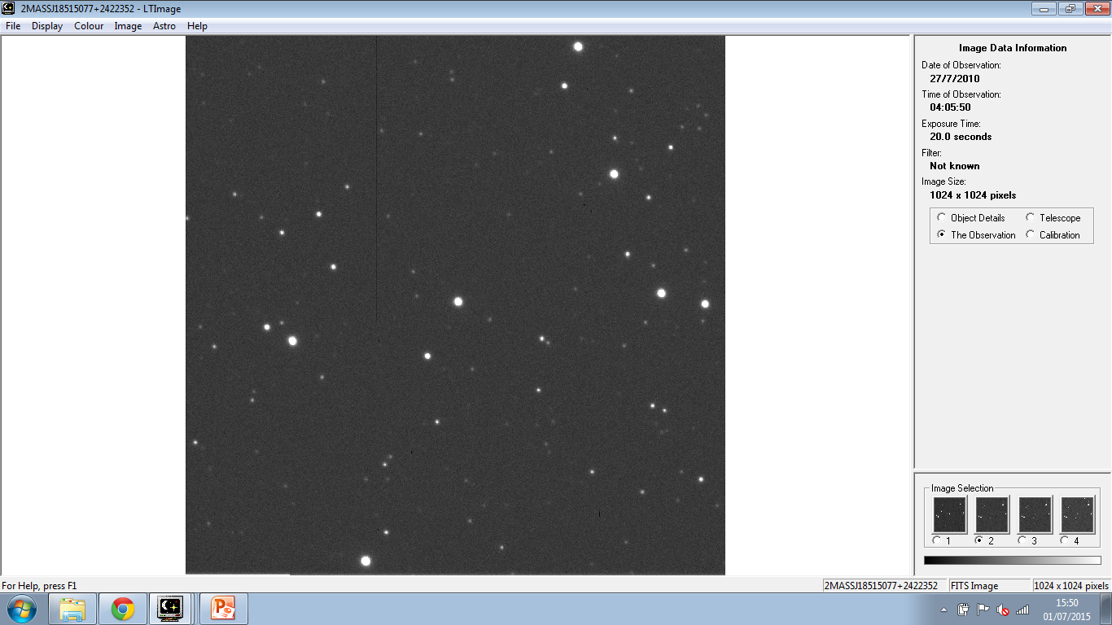
Methodology
Locate a variable star (circled in red)
Select a control star (circled in yellow)
Recorded the time and date of pictures taken of this star over a range of six hours.
We also recorded the apparent luminosity in photon count of both the variable and control star.

Slide 5
Control Star
Control Star

Slide 6
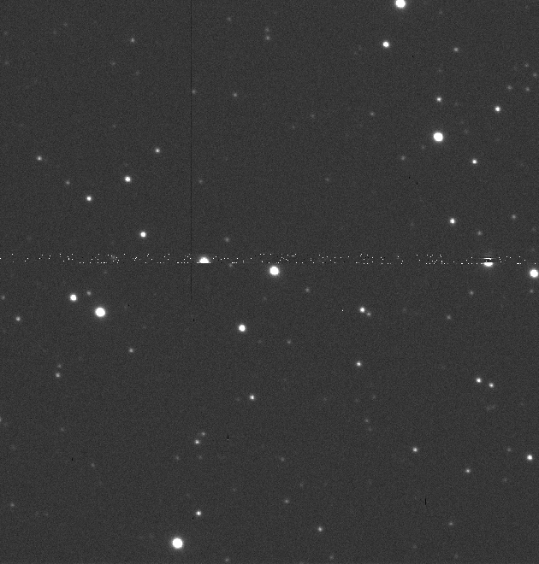
Variable Star

Slide 7
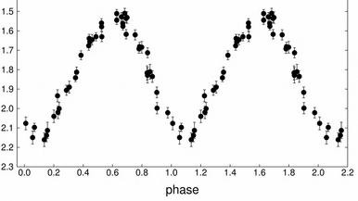
Cepheid Variable Star

Slide 8
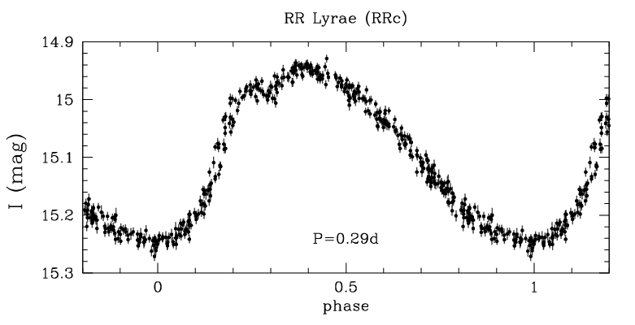
RR Lyrae Star

Slide 9
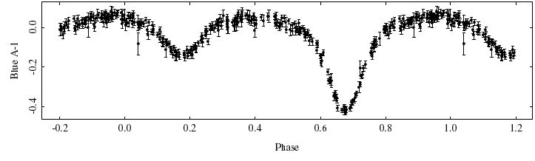
Eclipsing Binary Star

Slide 10
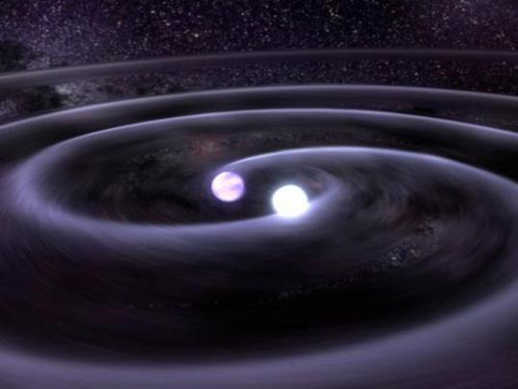
Conclusion
We based our conclusion on:
Period of the fluctuation
Magnitude of the star
Shape of the light curve

